Slide 1
Notes:
‹#›

Slide 2
Cellular Messaging
Cells can signal to each other and interpret the signals they receive from other cells and the environment
Signals are most often chemicals
The same small set of cell-signaling mechanisms shows up in diverse species and processes

Slide 3
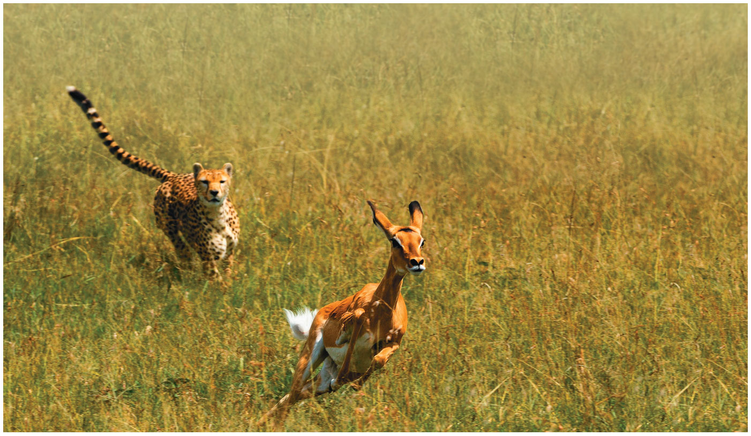
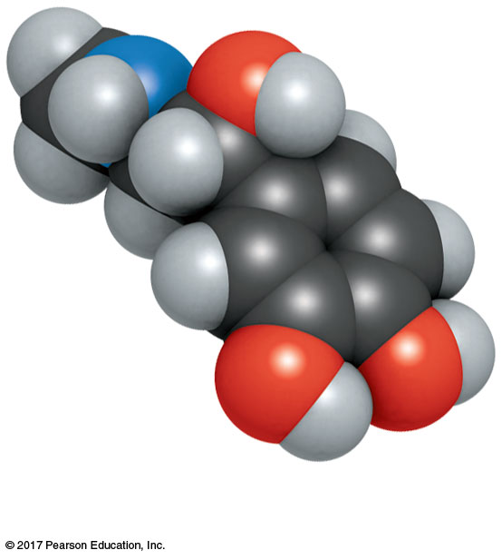
Figure 9.1
How does cell signaling trigger the desperate flight of this impala?
Epinephrine (adrenaline)
Notes:
Figure 9.1 How does cell signaling trigger the desperate flight of this impala?

Slide 4
Concept 9.1: External signals are converted to responses within the cell
Communication among microorganisms provides some insight into how cells send, receive, and respond to signals

Slide 5
Evolution of Cell Signaling
The yeast Saccharomyces cerevisiae has two mating types, a and α
Cells of different mating types locate each other via secreted factors specific to each type
The binding of a mating factor at the cell surface initiates a series of steps called a signal transduction pathway
Molecular details of signal transduction in yeasts and mammals are very similar.

Slide 6
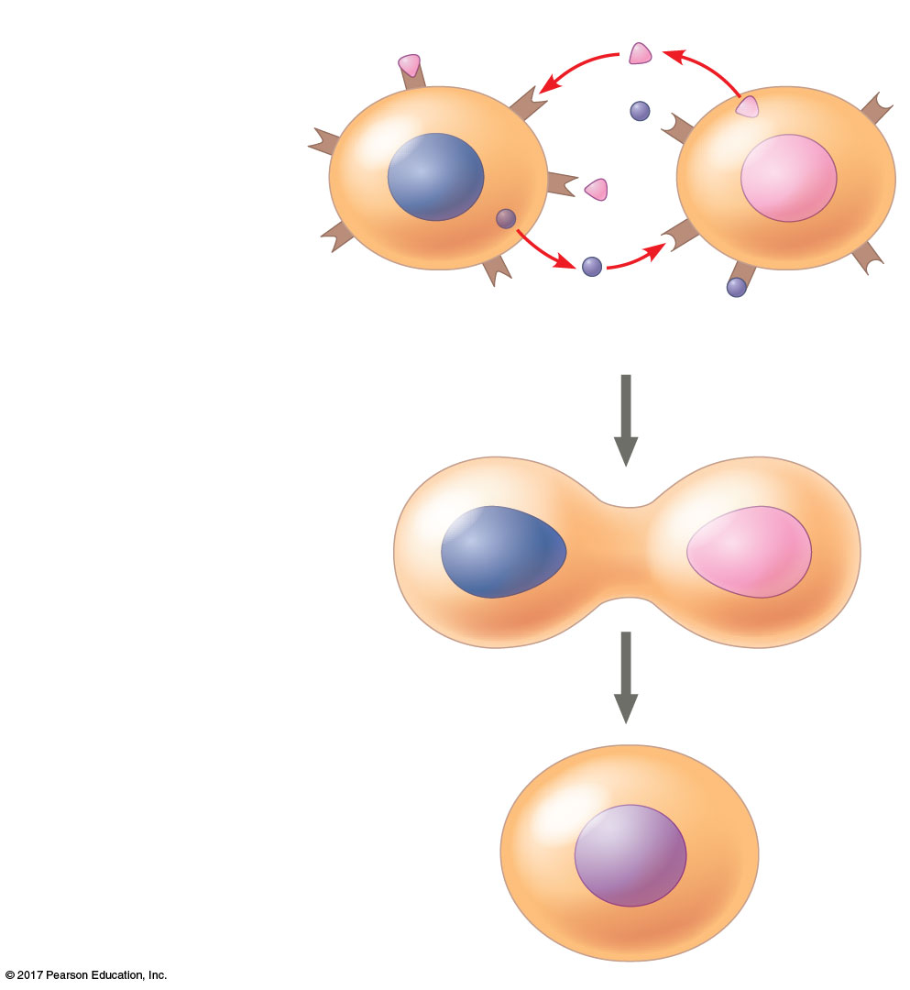
Figure 9.2_3
Receptor
α factor
1
Exchange of
mating factors
Communication between mating yeast cells
a
α
Yeast cell,
mating type a
a factor
Yeast cell,
mating type α
2
Mating
a
α
3
New a/α cell
a/α
Notes:
Figure 9.2_3 Communication between mating yeast cells (step 3)

Slide 7
Ancestral signaling molecules likely evolved in prokaryotes and single-celled eukaryotes and were adopted for use in their multicellular descendants
Cell signaling is critical among prokaryotes
A concentration of signaling molecules allows bacteria to sense local population density in a process called quorum sensing

Slide 8
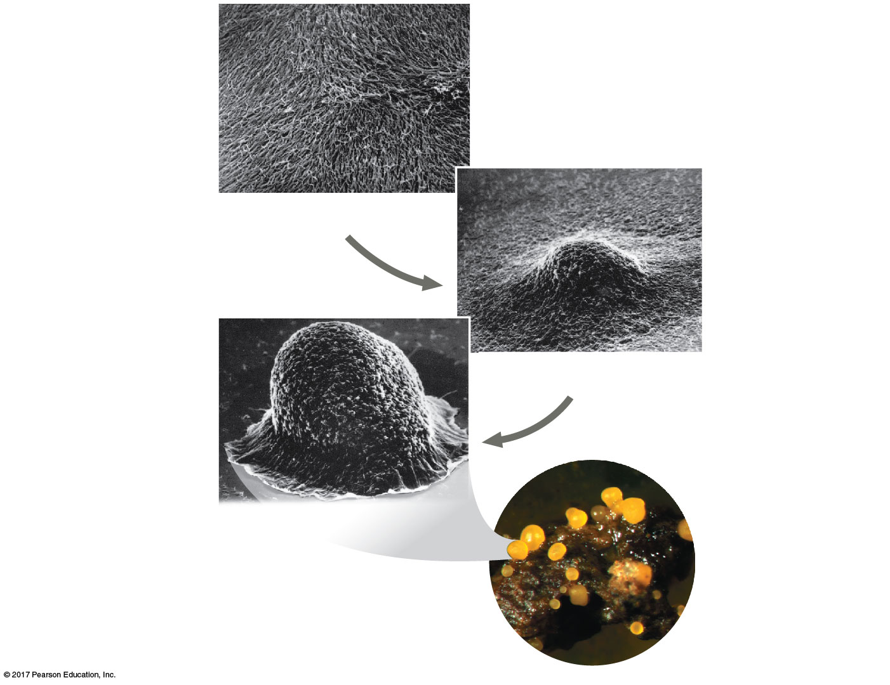
Figure 9.3
Communication among bacteria
1
Individual
rod-shaped
cells
2
Aggregation
in progress
0.5 mm
3
Spore-forming
structure
(fruiting body)
2.5 mm
Fruiting bodies
Notes:
Figure 9.3 Communication among bacteria

Slide 9
An example of quorum sensing群聚感應is the formation of a biofilm
A biofilm is an aggregation of bacterial cells adhered to a surface
Another example of medical importance is the secretion of toxins by infectious bacteria
Interfering with the signaling pathways used in quorum sensing may be a promising approach as an alternative to antibiotic treatment

Slide 10
Local and Long-Distance Signaling
Cells in a multicellular organism communicate via signaling molecules
In local signaling, animal cells may communicate by direct contact
Animal and plant cells have cell junctions that directly connect the cytoplasm of adjacent cells
Signaling substances in the cytosol can pass freely between adjacent cells

Slide 11
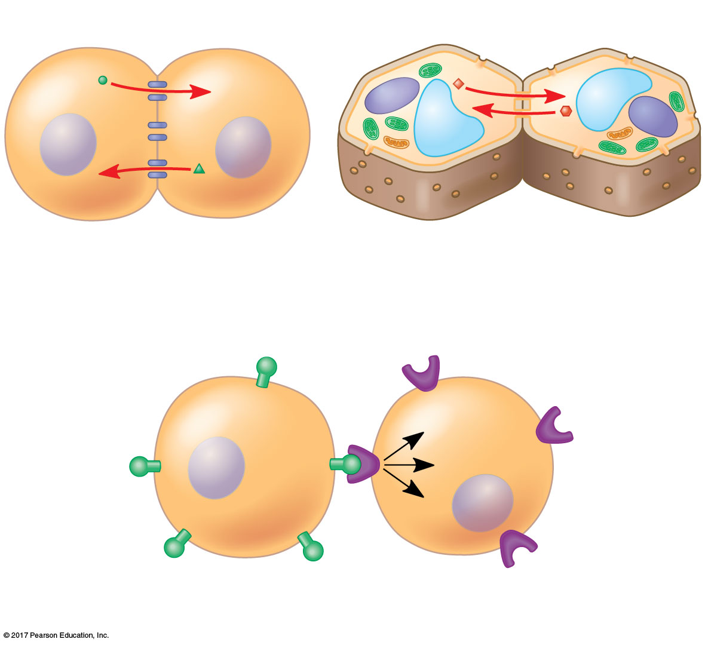
Figure 9.4
Plasma membranes
Cell wall
Gap junctions
between animal cells
Plasmodesmata原生質絲
between plant cells
(a) Cell junctions
Communication by direct contact between cells
(b) Cell-cell recognition
Notes:
Figure 9.4 Communication by direct contact between cells

Slide 12
In other cases, animal cells communicate using secreted messenger molecules that travel only short distances
Growth factors, which stimulate nearby target cells to grow and divide, are one class of such local regulators in animals
This type of local signaling in animals is called paracrine signaling旁分泌

Slide 13
Synaptic突觸signaling occurs in the animal nervous system when a neurotransmitter is released in response to an electric signal
Local signaling in plants is not well understood beyond communication between plasmodesmata

Slide 14
In long-distance signaling, plants and animals use chemicals called hormones
Hormonal signaling in animals is called endocrine內分泌signaling; specialized cells release hormones, which travel to target cells via the circulatory system
The ability of a cell to respond to a signal depends on whether or not it has a receptor specific to that signal

Slide 15
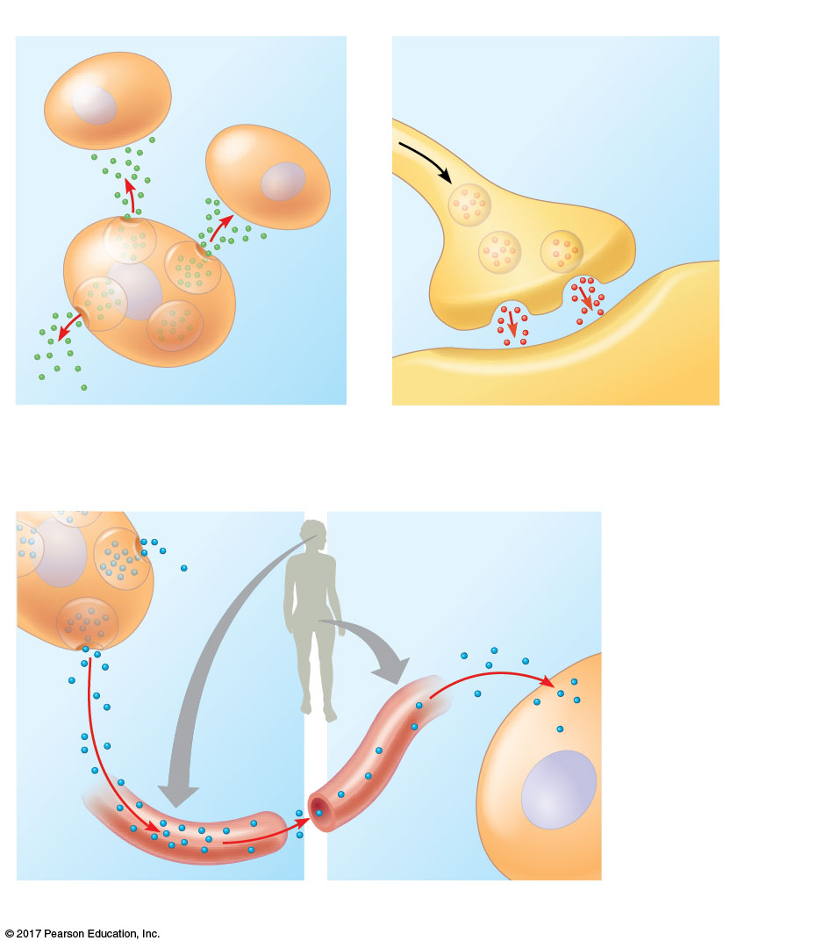
Figure 9.5
Local signaling
Target cells
Electrical signal triggers
release of neurotransmitter.
Neurotransmitter
diffuses across
synapse.
Signaling
cell
Secretory
vesicles
Local regulator
Target cell
(a) Paracrine signaling
(b) Synaptic signaling
Long-distance signaling
Endocrine cell
Target cell
specifically
binds
hormone.
Local and long-distance cell signaling by secreted molecules in animals
Hormone
travels in
bloodstream.
Blood
vessel
(c) Endocrine (hormonal) signaling
Notes:
Figure 9.5 Local and long-distance cell signaling by secreted molecules in animals

Slide 16
The Three Stages of Cell Signaling: A Preview
Earl W. Sutherland and colleagues discovered how the hormone epinephrine acts on cells
Sutherland suggested that cells receiving signals went through three processes
Reception
Transduction訊息傳遞
Response

Slide 17
In reception, the target cell detects a signaling molecule that binds to a receptor protein on the cell surface
In transduction, the binding of the signaling molecule alters the receptor and initiates a signal transduction pathway; transduction often occurs in a series of steps
In response, the transduced signal triggers a specific response in the target cell

Slide 18
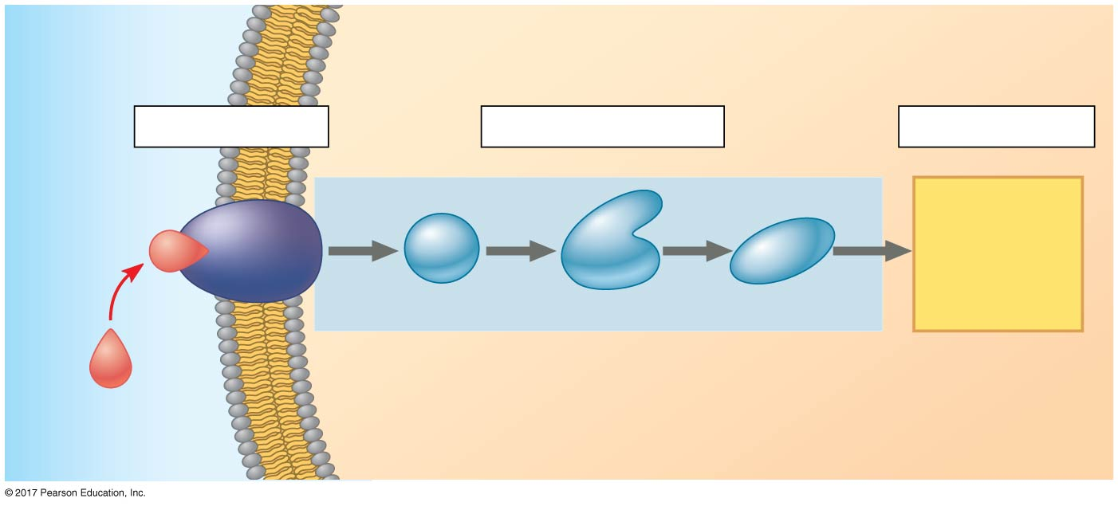
Figure 9.6_3
Overview of cell signaling
EXTRACELLULAR
FLUID
CYTOPLASM
Plasma membrane
1
Reception
2
Transduction
3
Response
Receptor
Activation
of cellular
response
1
2
3
Relay molecules
Signaling
molecule
Notes:
Figure 9.6_3 Overview of cell signaling (step 3)

Slide 19
Concept 9.2: Reception: A signaling molecule binds to a receptor protein, causing it to change shape
The binding between a signal molecule (ligand配體能與受体結合以產生某種生理效果的物質。) and receptor is highly specific
A shape change in a receptor is often the initial transduction of the signal
Most signal receptors are plasma membrane proteins

Slide 20
Receptors in the Plasma Membrane
G protein-coupled receptors (GPCRs) are the largest family of cell-surface receptors
Most water-soluble signal molecules bind to specific sites on receptor proteins that span the plasma membrane

Slide 21
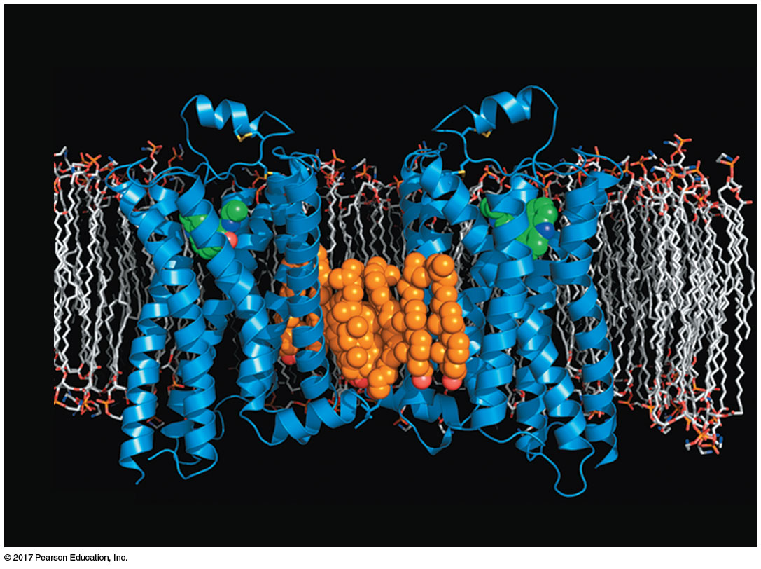
Figure 9.7
The structure of a G protein-coupled receptor (GPCR)
β₂-adrenergic
receptors
Molecule
that mimics
ligand
Plasma membrane
Cholesterol
Notes:
Figure 9.7 The structure of a G protein-coupled receptor (GPCR)

Slide 22
There are three main types of membrane receptors:
G protein-coupled receptors
Receptor tyrosine kinases
Ion channel receptors

Slide 23
G protein-coupled receptors (GPCRs G蛋白偶聯受體) are cell-surface transmembrane receptors that work with the help of a G protein
G proteins bind the energy-rich GTP
G proteins are all very similar in structure
GPCR systems are extremely widespread and diverse in their functions

Slide 24
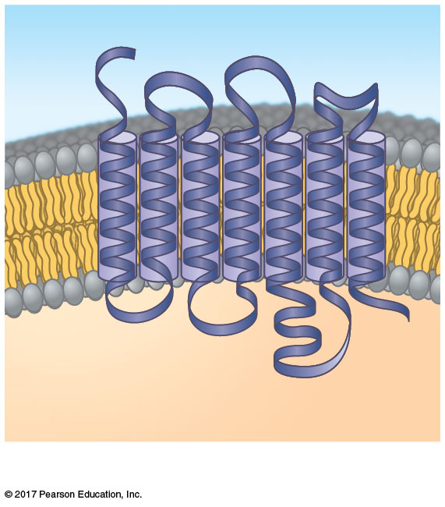
Figure 9.8a
GPCR ribbon model
Signaling molecule binding site
Segment that
interacts with
G proteins inside the cell
G protein-coupled receptor
Notes:
Figure 9.8a Exploring cell-surface transmembrane receptors (part 1: GPCR ribbon model)

Slide 25
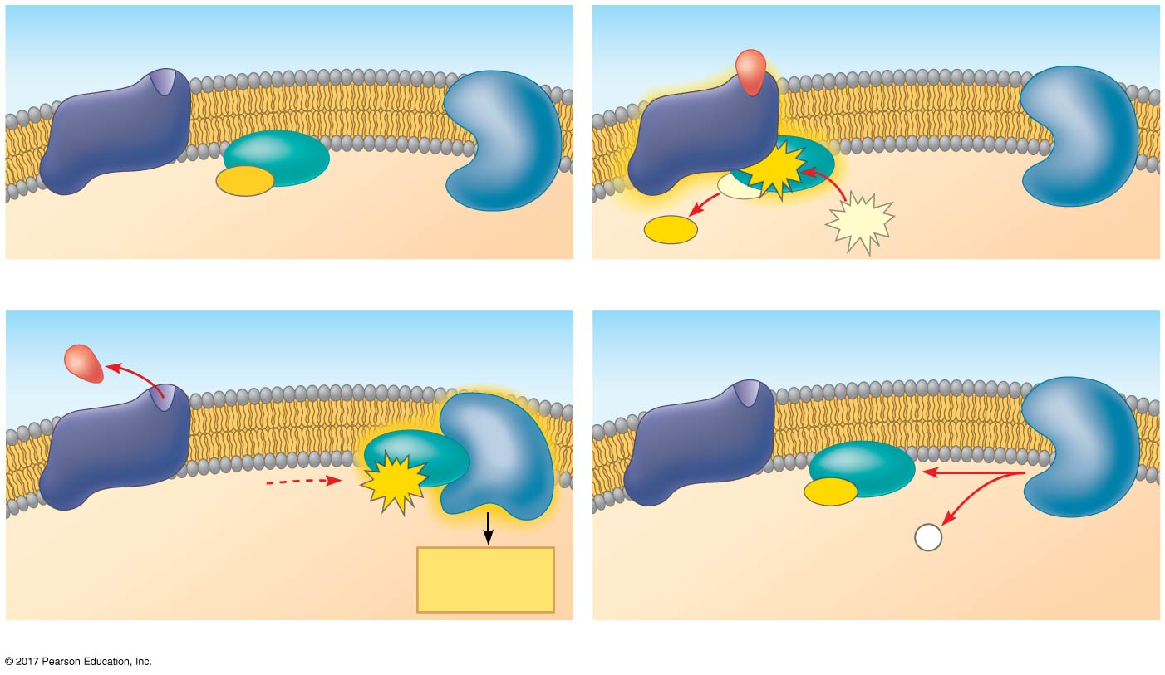
Figure 9.8b
GPCR signaling
G protein-coupled
receptor
Plasma membrane
Activated
receptor
Signaling
molecule
GDP
GTP
G protein
(inactive)
Inactive
enzyme
Enzyme
GDP
GTP
1
2
Activated
enzyme
EXTRACELLULAR
GTP
GDP
P
i
Cellular
response
CYTOPLASM
3
4
Notes:
Figure 9.8b Exploring cell-surface transmembrane receptors (part 2: GPCR signaling)

Slide 26
Receptor tyrosine kinases受体酪氨酸激酶(RTKs) are membrane receptors that transfer phosphate groups from ATP to another protein
A receptor tyrosine kinase can trigger multiple signal transduction pathways at once
Abnormal functioning of RTKs is associated with many types of cancers

Slide 27
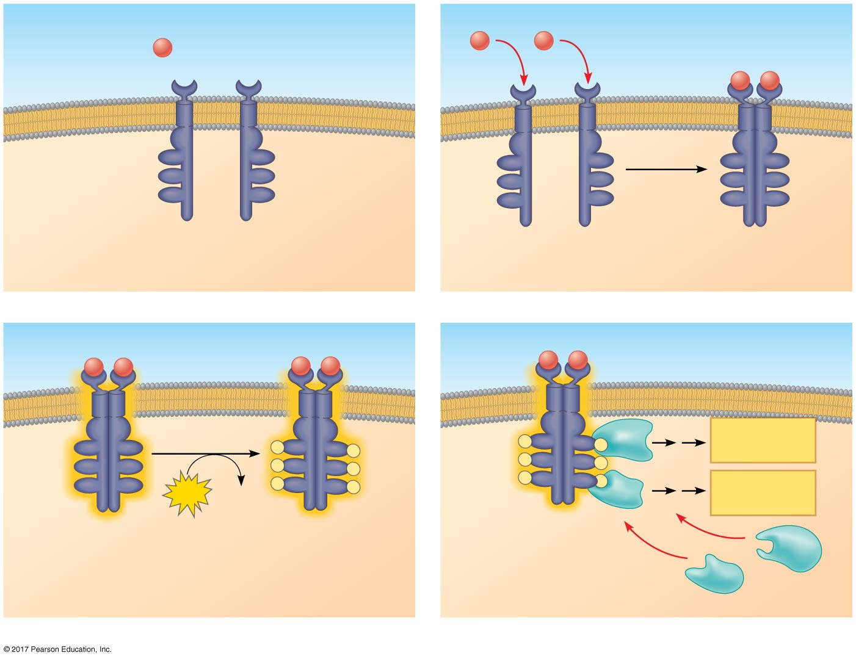
Figure 9.8c
Receptor tyrosine kinases (RTKs)
Signaling molecule
(ligand)
Signaling molecule
EXTRACELLULAR
Ligand-binding site
α helix in the
membrane
Tyrosines
Tyr
Tyr
Tyr
Tyr
Tyr
Tyr
Tyr
Tyr
Tyr
Tyr
Tyr
Tyr
Tyr
Tyr
Tyr
Tyr
Tyr
Tyr
Receptor tyrosine
kinase proteins
(inactive monomers)
Dimer
CYTOPLASM
1
2
Activated
relay proteins
Tyr
Cellular
response 1
Tyr
Tyr
P
Tyr
Tyr
P
P
Tyr
P
Tyr
Tyr
P
Tyr
Tyr
P
P
Tyr
Tyr
P
Tyr
Tyr
6
P
Tyr
Tyr
P
P
Tyr
Tyr
P
Cellular
response 2
ATP
6 ADP
Activated tyrosine
kinase regions
(unphosphorylated
dimer)
Fully activated receptor
tyrosine kinase
(phosphorylated
dimer)
Inactive
relay proteins
3
4
Notes:
Figure 9.8c Exploring cell-surface transmembrane receptors (part 3: RTKs)

Slide 28
A ligand-gated ion channel receptor acts as a gate that opens and closes when the receptor changes shape
When a signal molecule binds as a ligand to the receptor, the gate allows specific ions, such as Na⁺ or Ca²⁺, through a channel in the receptor

Slide 29
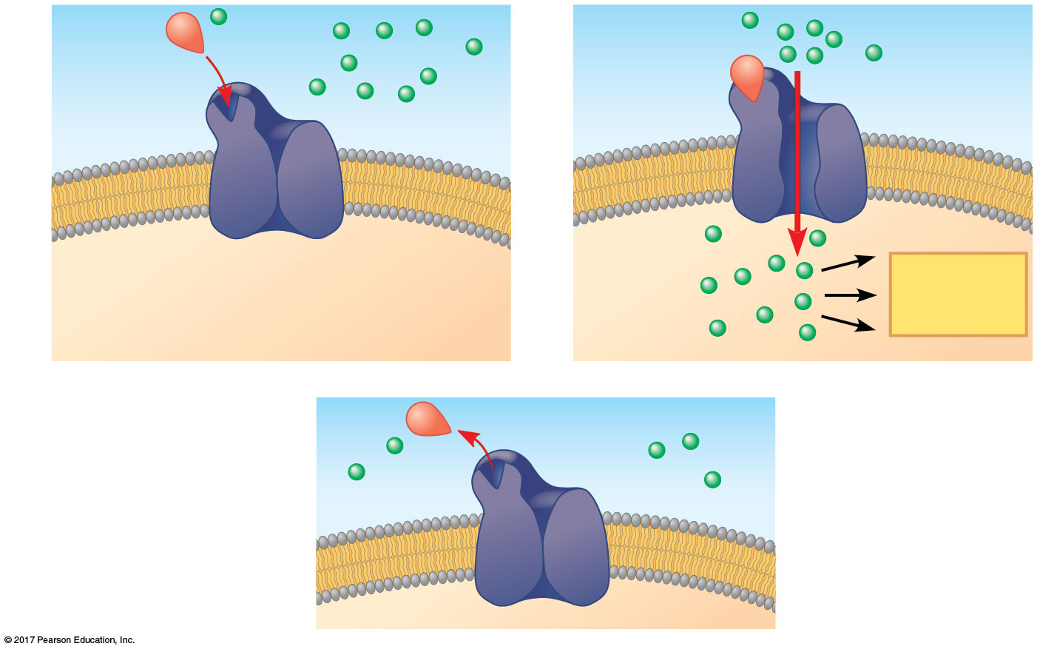
Figure 9.8d_3
Ion channel receptors
1
2
Channel open
Channel
closed
Ions
Signaling
molecule
(ligand)
Plasma
membrane
Cellular
response
Ligand-gated
ion channel receptor
3
Channel closed
Notes:
Figure 9.8d_3 Exploring cell-surface transmembrane receptors (part 4: ion channel receptors, step 3)

Slide 30
Intracellular Receptors細胞內受體
Intracellular receptor proteins are found in the cytoplasm or nucleus of target cells
Small or hydrophobic chemical messengers can readily cross the membrane and activate receptors
Examples of hydrophobic messengers are the steroid and thyroid hormones of animals
An activated hormone-receptor complex can act as a transcription factor, turning on or off specific genes

Slide 31
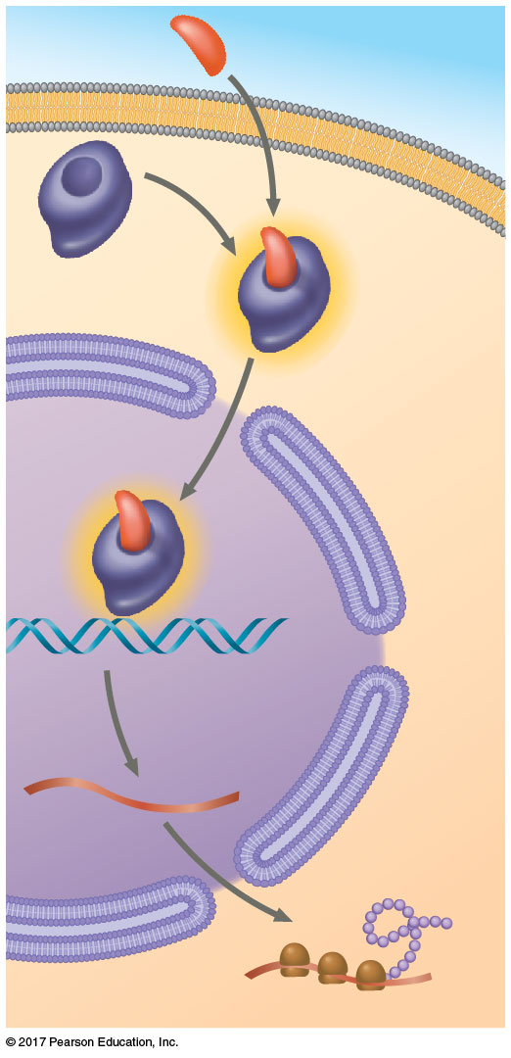
Figure 9.9
Steroid hormone interacting with an intracellular receptor
Hormone
(aldosterone)
EXTRA-
CELLULAR
FLUID
Plasma
membrane
Receptor
protein
Hormone-
receptor
complex
DNA
mRNA
New
protein
NUCLEUS
CYTOPLASM
Notes:
Figure 9.9 Steroid hormone interacting with an intracellular receptor

Slide 32
Concept 9.3: Transduction: Cascades of molecular interactions relay signals from receptors to target molecules in the cell
Cell signaling is usually a multistep process
Multistep pathways can greatly amplify a signal
Multistep pathways provide more opportunities for coordination and regulation of the cellular response

Slide 33
Signal Transduction Pathways
The binding of a signaling molecule to a receptor triggers the first step in a chain of molecular interactions
The receptor activates another protein, which activates another, and so on, until the protein producing the response is activated
At each step, the signal is transduced into a different form, usually a shape change in a protein

Slide 34
Protein Phosphorylation and Dephosphorylation
Phosphorylation and dephosphorylation of proteins is a widespread cellular mechanism for regulating protein activity
Protein kinases蛋白激酶transfer phosphates from ATP to protein, a process called phosphorylation
Many relay molecules in signal transduction pathways are protein kinases, creating a phosphorylation cascade

Slide 35
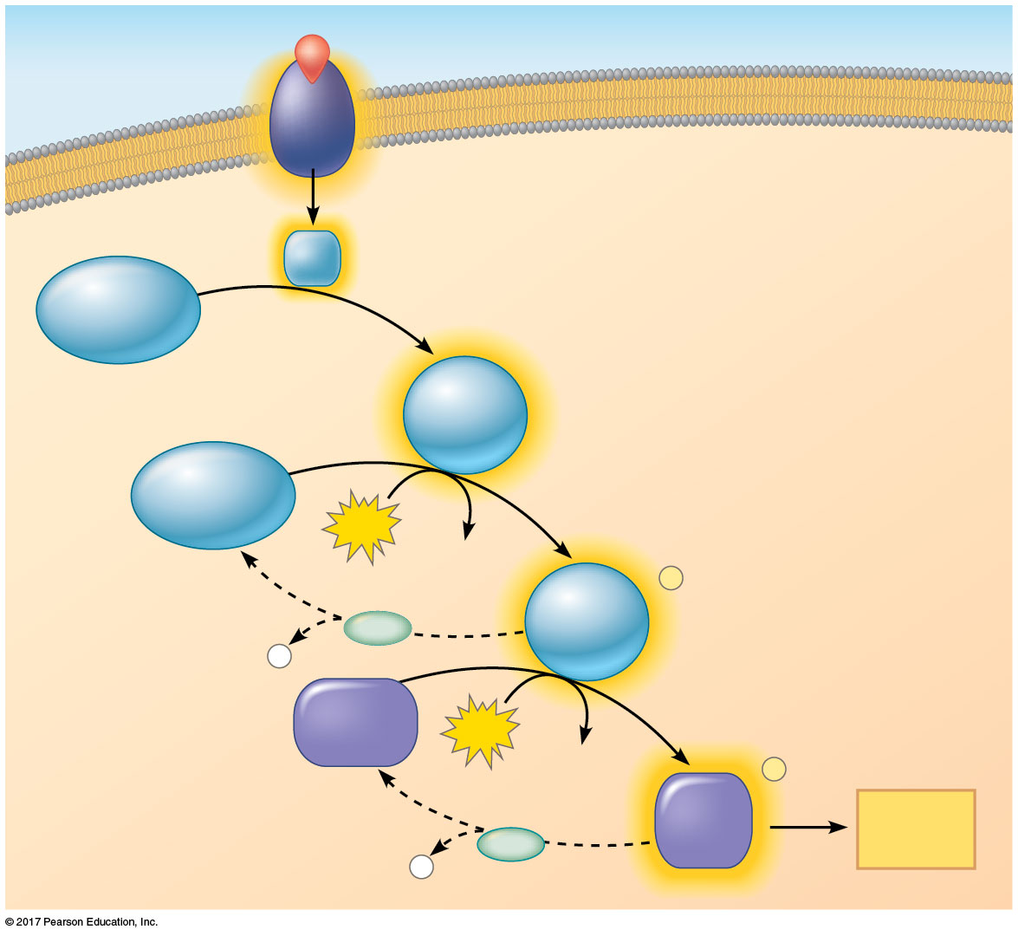
Figure 9.10
A phosphorylation cascade
Signaling molecule
Activated relay
molecule
Receptor
Inactive
protein kinase
1
Active
protein
kinase
Inactive
protein kinase
1
Phosphorylation cascade
2
ATP
ADP
Active
protein
kinase
P
PP
P
i
2
Inactive
protein
ATP
ADP
P
Active
protein
Cellular
response
PP
P
i
Notes:
Figure 9.10 A phosphorylation cascade

Slide 36
Protein phosphatases蛋白質脫磷酸化酵素rapidly remove the phosphates from proteins, a process called dephosphorylation
This phosphorylation and dephosphorylation system acts as a molecular switch, turning activities on and off or up or down, as required

Slide 37
Small Molecules and Ions as Second Messengers
Many signaling pathways involve second messengers
These are small, nonprotein, water-soluble molecules or ions that spread throughout a cell by diffusion
Second messengers participate in pathways initiated by GPCRs and RTKs
Cyclic AMP and calcium ions are common second messengers

Slide 38
Cyclic AMP
Cyclic AMP (cAMP) is one of the most widely used second messengers
Adenylyl cyclase, an enzyme in the plasma membrane, converts ATP to cAMP in response to an extracellular signal

Slide 39
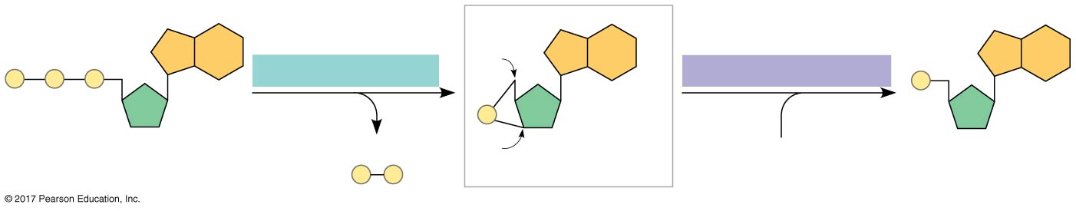
Figure 9.11
Cyclic AMP
Adenylyl cyclase
5′C
Phosphodiesterase
P
P
P
P
P
ATP
Pyrophosphate
3′C
cAMP
H₂O
AMP
P
P
i
Notes:
Figure 9.11 Cyclic AMP

Slide 40
Many signal molecules trigger formation of cAMP
Other components of cAMP pathways are G proteins, G protein-coupled receptors, and protein kinases
cAMP usually activates protein kinase A, which phosphorylates various other proteins
Further regulation of cell metabolism is provided by G protein systems that inhibit adenylyl cyclase

Slide 41
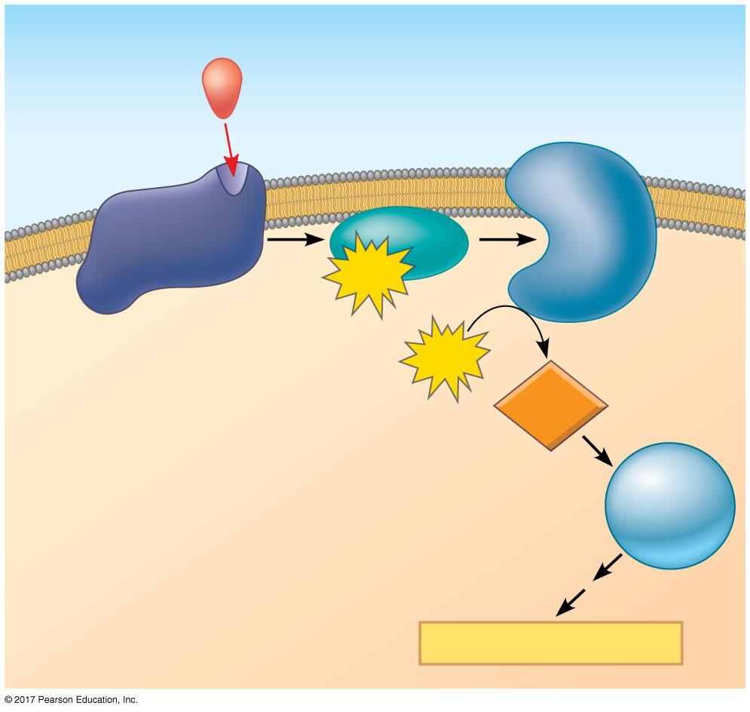
Figure 9.12
cAMP as a second messenger in a G protein signaling pathway
First messenger
(signaling molecule
such as epinephrine)
G protein-
coupled
receptor
(GPCR)
Adenylyl
cyclase
1
G protein
2
GTP
3
ATP
4
Second
messenger
cAMP
Protein
kinase A
5
Cellular responses
Notes:
Figure 9.12 cAMP as a second messenger in a G protein signaling pathway

Slide 42
Understanding of the role of cAMP in G protein signaling pathways helps explain how certain microbes cause disease
The cholera bacterium, Vibrio cholerae, produces a toxin that modifies a G protein so that it is stuck in its active form
This protein continually makes cAMP, causing intestinal cells to secrete large amounts of salt into the intestines
Water follows by osmosis, and an untreated person can soon die from loss of water and salt

Slide 43
Calcium Ions and Inositol Triphosphate (IP₃)
Calcium ions (Ca²⁺) are used widely as a second messenger
Ca²⁺ can function as a second messenger because its concentration in the cytosol is normally much lower than the concentration outside the cell
A small change in number of calcium ions thus represents a relatively large percentage change in calcium concentration

Slide 44
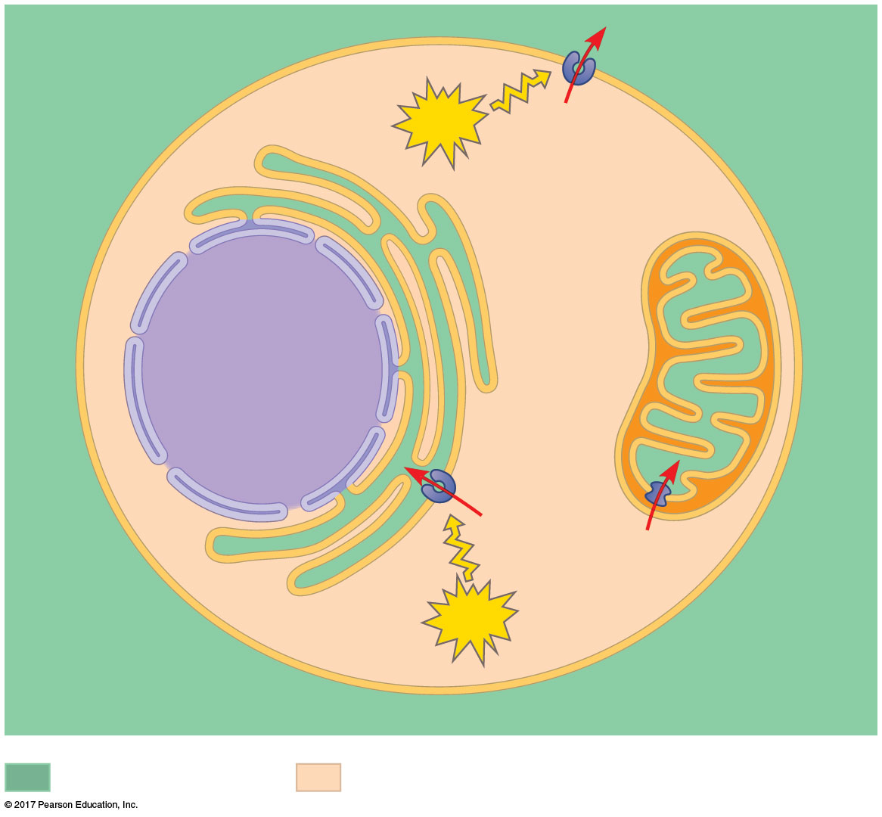
Figure 9.13
Endoplasmic
reticulum (ER)
Plasma
membrane
ATP
Mitochondrion
Nucleus
Ca²⁺
pump
CYTOSOL
ATP
EXTRACELLULAR
FLUID
The maintenance of calcium ion concentrations in an animal cell
High [Ca²⁺]
Low [Ca²⁺]
Notes:
Figure 9.13 The maintenance of calcium ion concentrations in an animal cell

Slide 45
A signal relayed by a signal transduction pathway may trigger an increase in calcium in the cytosol
Pathways leading to the release of calcium involve inositol triphosphate (IP₃) and diacylglycerol (DAG) as additional second messengers
These two are produced by cleavage of a certain phospholipid in the plasma membrane

Slide 46
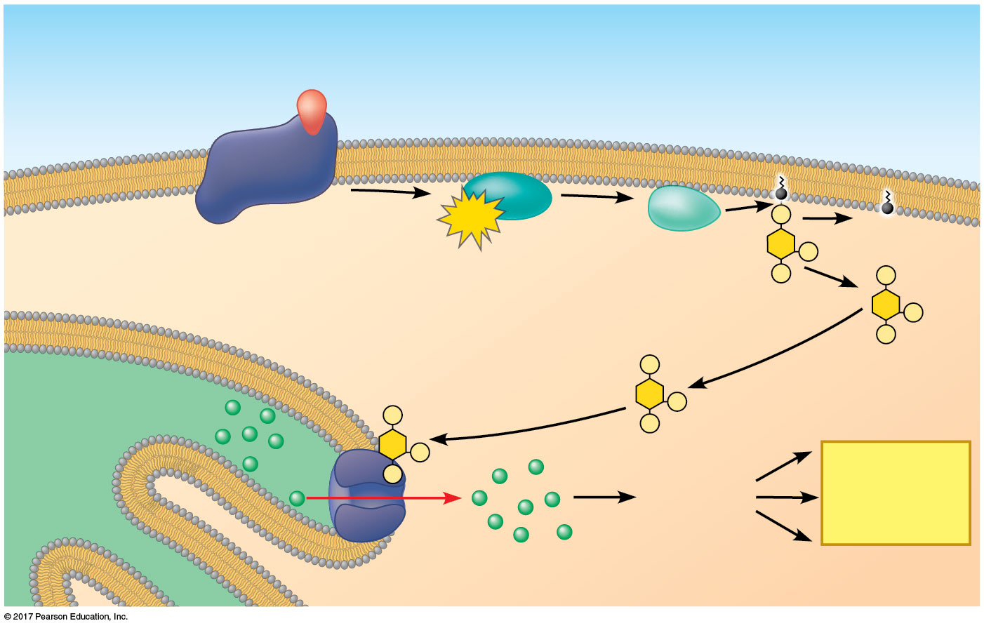
Figure 9.14_3
Calcium and IP₃ in signaling pathways
EXTRA-
CELLULAR
FLUID
Signaling molecule
(first messenger)
G protein
GTP
DAG
CYTOSOL
G protein-coupled
receptor
Phospholipase C
PIP₂
IP₃-gated
calcium channel
Endoplasmic
reticulum (ER)
lumen
IP₃
(second messenger)
Ca²⁺
Various
proteins
activated
Cellular
responses
Ca²⁺
(second
messenger)
Notes:
Figure 9.14_3 Calcium and IP₃ in signaling pathways (step 3)

Slide 47
Concept 9.4: Response: Cell signaling leads to regulation of transcription or cytoplasmic activities
The cell’s response to an extracellular signal is called the “output response”

Slide 48
Nuclear and Cytoplasmic Responses
Ultimately, a signal transduction pathway leads to regulation of one or more cellular activities
The response may occur in the nucleus or in the cytoplasm
Many signaling pathways regulate the synthesis of enzymes or other proteins, usually by turning genes on or off in the nucleus
The final activated molecule in the signaling pathway may function as a transcription factor

Slide 49
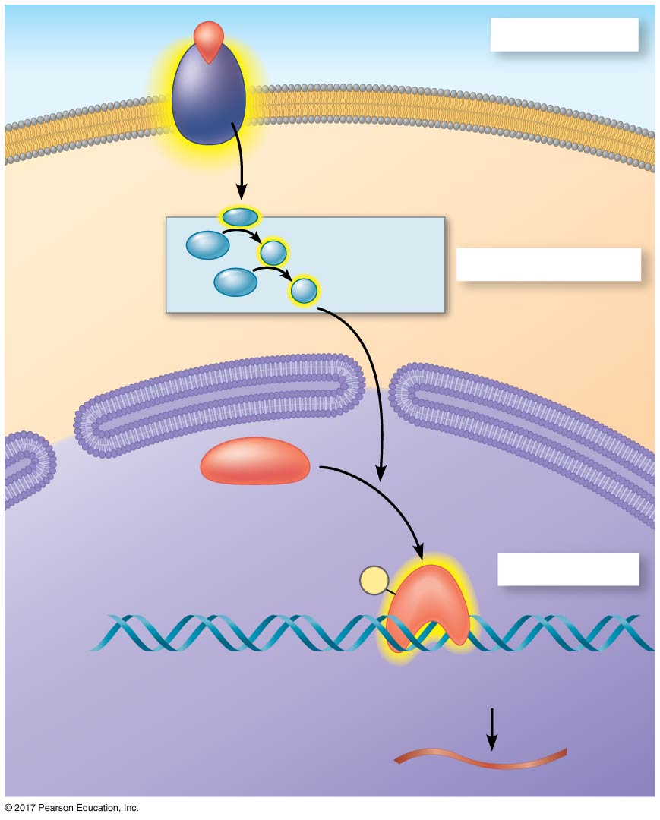
Figure 9.15
Nuclear responses to a signal: the activation of a specific gene by a growth factor
Growth factor
Reception
Receptor
Phospho-
rylation
cascade
Transduction
CYTOPLASM
Inactive
transcription
factor
Active
transcription
factor
P
Response
DNA
Gene
NUCLEUS
mRNA
Notes:
Figure 9.15 Nuclear responses to a signal: the activation of a specific gene by a growth factor

Slide 50
Other pathways may regulate the activity of enzymes rather than their synthesis
For example, a signal could cause opening or closing of an ion channel in the plasma membrane or a change in cell metabolism

Slide 51
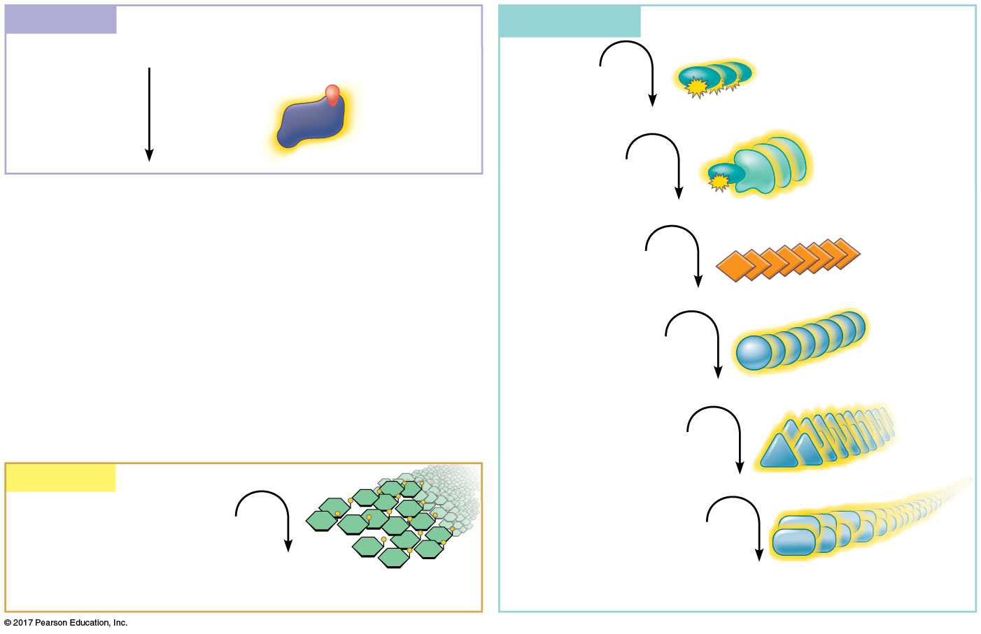
Figure 9.16
Cytoplasmic response to a signal: the stimulation of glycogen breakdown by epinephrine (adrenaline)
Reception
Transduction
Binding of epinephrine to G protein-coupled
receptor
(1 molecule)
Inactive
G protein
Active G protein (10² molecules)
Inactive
adenylyl cyclase
Active adenylyl cyclase (10²)
ATP
Cyclic AMP (10⁴)
Inactive
protein kinase A
Active protein kinase A (10⁴)
Inactive
phosphorylase kinase
Response
Active phosphorylase kinase (10⁵)
Glycogen
Inactive
glycogen phosphorylase
Glucose 1-phosphate
Active glycogen phosphorylase (10⁶)
(10⁸ molecules)
Notes:
Figure 9.16 Cytoplasmic response to a signal: the stimulation of glycogen breakdown by epinephrine (adrenaline)

Slide 52
Signaling pathways can also affect the overall behavior of a cell; for example, a signal could lead to cell division

Slide 53
Regulation of the Response
A response to a signal may not be simply “on” or “off”
There are four aspects of signal regulation:
Amplification of the signal (and thus the response)
Specificity of the response
Overall efficiency of response, enhanced by scaffolding proteins
Termination of the signal

Slide 54
Signal Amplification
Enzyme cascades amplify the cell’s response to the signal
At each step, the number of activated products can be much greater than in the preceding step

Slide 55
The Specificity of Cell Signaling and Coordination of the Response
Different kinds of cells have different collections of proteins
These different proteins allow cells to detect and respond to different signals
The same signal can have different effects in cells with different proteins and pathways
Pathway branching and “cross-talk” further help the cell coordinate incoming signals

Slide 56
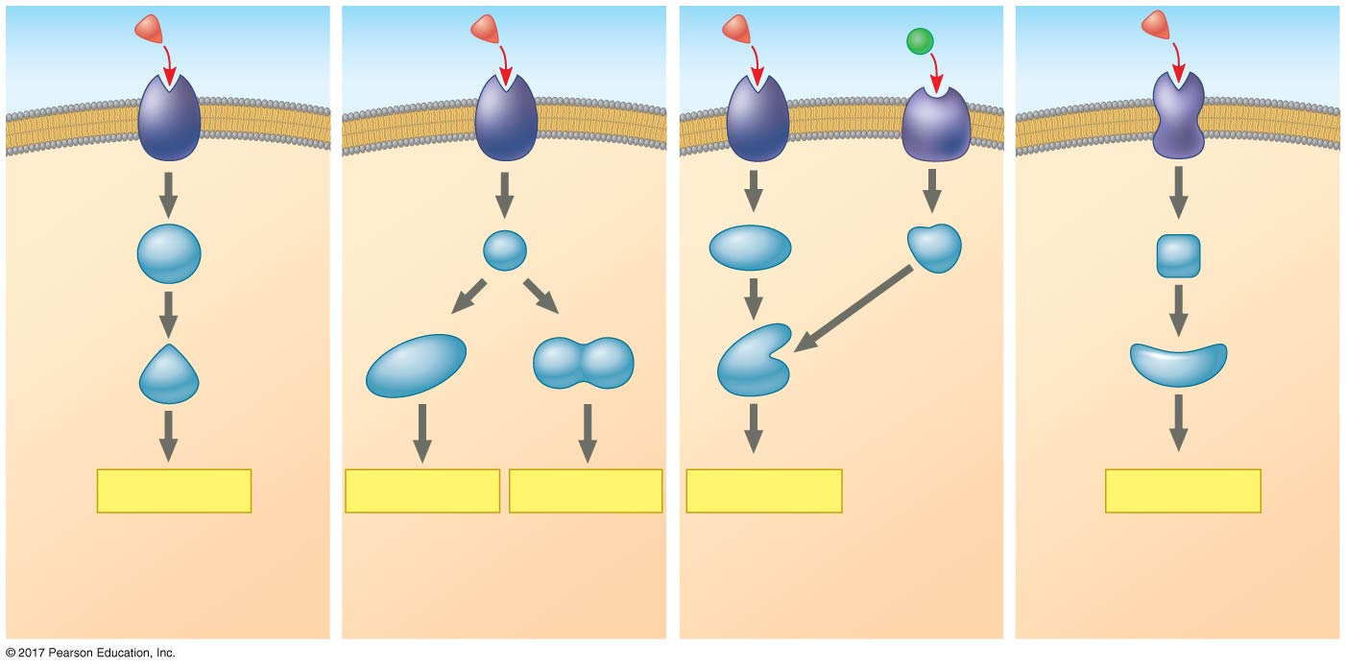
Figure 9.17
The specificity of cell signaling
Signaling
molecule
Receptor
Relay
mole-
cules
Activation
or inhibition
Response 1
Response 2
Response 3
Response 4
Response 5
Cell A: Pathway leads
to a single response.
Cell B: Pathway
branches, leading to
two responses.
Cell C: Cross-talk
occurs between two
pathways.
Cell D: Different
receptor leads to a
different response.
Notes:
Figure 9.17 The specificity of cell signaling

Slide 57
Signaling Efficiency: Scaffolding Proteins and Signaling Complexes
Scaffolding proteins are large relay proteins to which other relay proteins are attached
Scaffolding proteins can increase the signal transduction efficiency by grouping together different proteins involved in the same pathway
In some cases, scaffolding proteins may also help activate some of the relay proteins

Slide 58
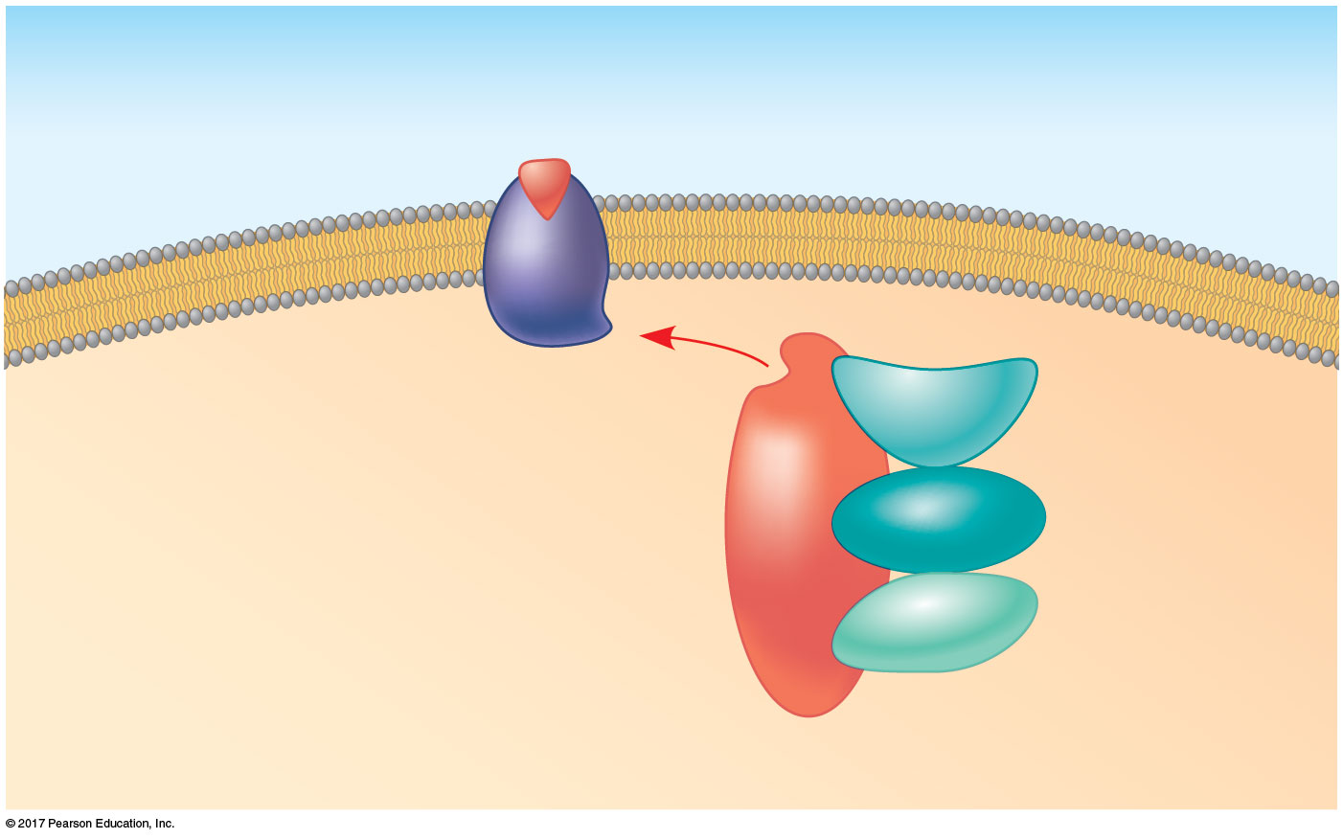
Figure 9.18
A scaffolding protein
Signaling
molecule
Plasma
membrane
Receptor
Three
different
protein
kinases
Scaffolding
protein
Notes:
Figure 9.18 A scaffolding protein

Slide 59
Termination of the Signal
Inactivation mechanisms are an essential aspect of cell signaling
If the concentration of external signaling molecules falls, fewer receptors will be bound
Unbound receptors revert to an inactive state

Slide 60
Concept 9.5: Apoptosis细胞凋亡integrates multiple cell-signaling pathways
Cells that are infected, damaged, or at the end of their functional lives often undergo “programmed cell death”
Apoptosis is the best-understood type
Components of the cell are chopped up and packaged into vesicles that are digested by scavenger cells
Apoptosis prevents enzymes from leaking out of a dying cell and damaging neighboring cells

Slide 61
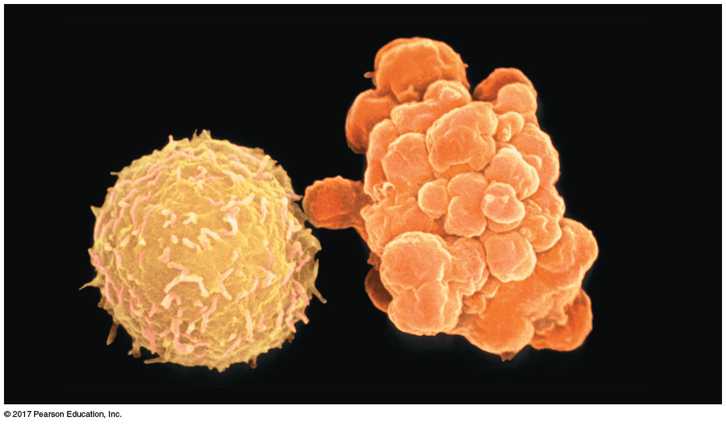
Figure 9.19
Apoptosis of a human white blood cell
2 µm
Notes:
Figure 9.19 Apoptosis of a human white blood cell

Slide 62
Apoptosis in the Soil Worm Caenorhabditis elegans
In worms and other organisms, apoptosis is triggered by signals that activate a cascade of “suicide” proteins in the cells programmed to die
When the death signal is received, an apoptosis-inhibiting protein (Ced-9) is inactivated, triggering a cascade of caspase proteins that promote apoptosis
The chief caspase in the nematode is called Ced-3

Slide 63
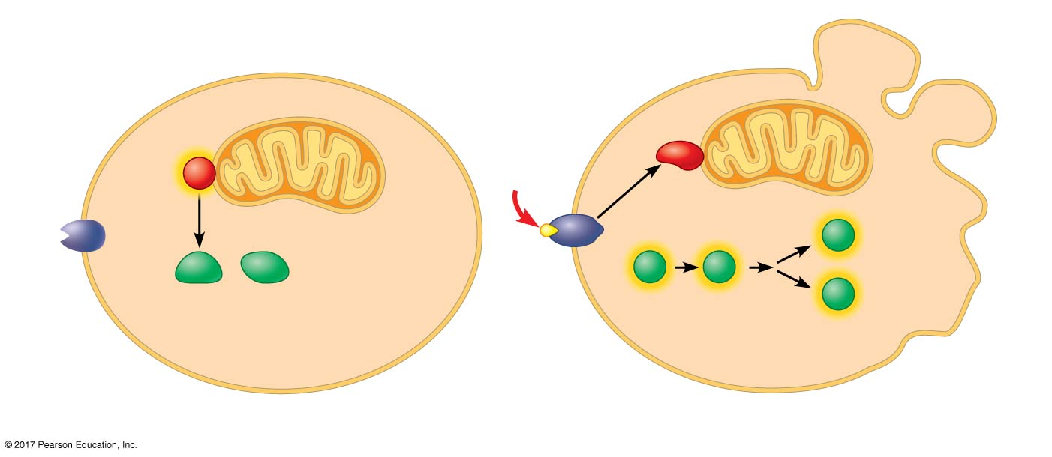
Figure 9.20
Molecular basis of apoptosis in C. elegans
Active Ced-9 protein
inhibits Ced-4 activity.
Inactive Ced-9 does
not inhibit Ced-4.
Cell
forms
blebs
Mitochondrion
Death-
signaling
molecule
Active
Active
Ced-4
Ced-3
Nucleases
Other
proteases
Ced-4
Ced-3
Activation
cascade
Receptor
for death-
signaling
molecule
Inactive proteins
(a) No death signal
(b) Death signal
Notes:
Figure 9.20 Molecular basis of apoptosis in C. elegans

Slide 64
Apoptotic Pathways and the Signals That Trigger Them
In humans and other mammals, several different pathways, including about 15 caspases, can carry out apoptosis
Apoptosis can be triggered by signals from outside the cell or inside it
Internal signals can result from irreparable DNA damage or excessive protein misfolding

Slide 65
Apoptosis evolved early in animal evolution and is essential for the development and maintenance of all animals
For example, apoptosis is a normal part of development of hands and feet in humans (and paws in other mammals)
Apoptosis may be involved in some diseases (for example, Parkinson’s and Alzheimer’s); interference with apoptosis may contribute to some cancers

Slide 66
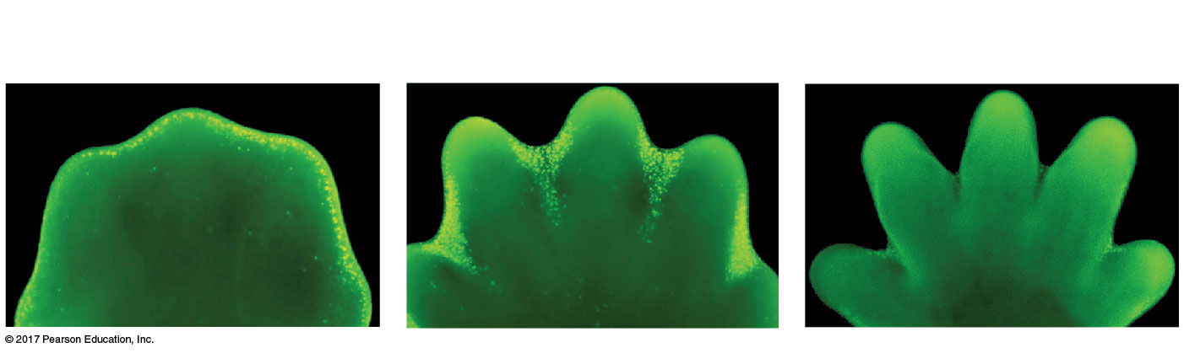
Figure 9.21
Effect of apoptosis during paw development in the mouse
Interdigital
tissue
Cells undergoing
apoptosis
Space between
digits
1 mm
Notes:
Figure 9.21 Effect of apoptosis during paw development in the mouse

